Slide 1
Webscraping Project
Property Rental
Team BCC
Benny
Ching
Chloe
Notes:
Blind Carbon Copy

Slide 2
OUR AIM - BACKGROUND
Increasing demand for property rental
Overwhelming listing
Skyrocketing real estate price, leads to higher preference for property rental
Different listing among different agencies, hard to make comparison
(Blank)
Limited search filter
Search filter on each agency could not be much customized, (eg by floor, by size or by district)
(blank)

Slide 3


OUR AIM - PLANS
Brainstorming
○ What data can we get from the web?
○ What is the web structure?
○ What kind of comparison we can make?
○ What kind of comparison is most valuable to stakeholders?
Data Collection
Web scraping
Used 2 popular property rental agency web to extract data
Data Preprocessing
Data cleaning
Remove the uniterable elements, and transform its type or format for further analysis
Data Visualizing
Plotting graphs for easier comparison and more
reader-friendly

Slide 4
BUSINESS VALUE
TENANT
○ Grasp the latest market trends
○ Explore new investment
opportunities
○ Optimize the rental price,
maximize profitability
○ Search for best deal among
different agencies
○ Compare price/sq.ft among
districts at once
○ Comprehensive comparison
(eg. by levels of floor, by size)
LANDLORD

Slide 5
DATA COLLECTION - webscraping/API, libraries used
Study the websites and select useful information for analysis
01
Import BeautifulSoup
Web Scraping
Inspect the elements (HTML layers, buttons)
From selenium import webdriver
(incl. WebDriverWait, By, expected_conditions)
02
Import requests
Import json
Loop over the webpages and scrape the desirable data
03
Import pandas
Data Processing
Import matplotlib.pyplot

Slide 6
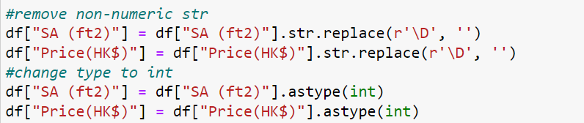
DATA PREPROCESSING
Convert data type from string to Datetime/integer format
2. Create a new column to compare price per square feet

Slide 7
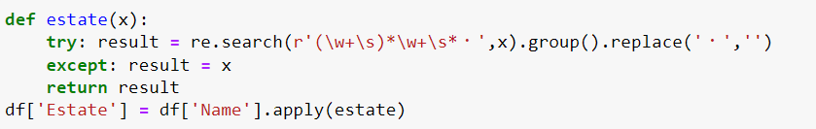
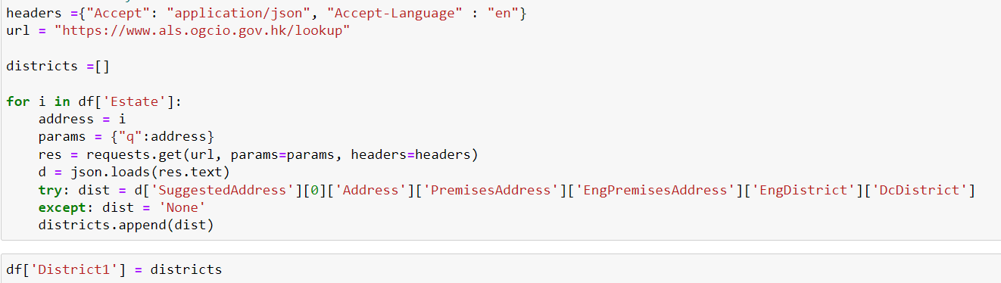
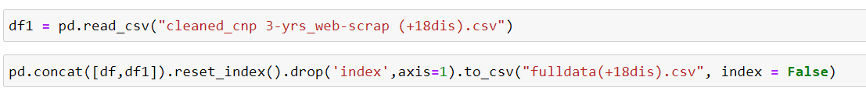
DATA PREPROCESSING
3. Leverage Gov. API to create a new column ‘Estate’ to filter by districts
4. Combine cleaned datasets from different websites

Slide 8
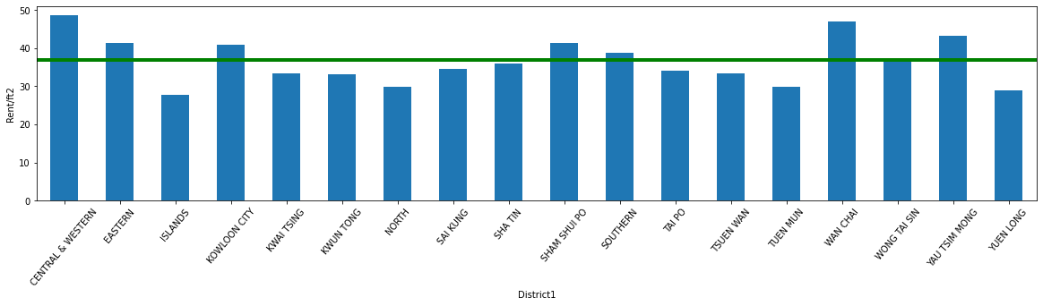
ANALYSIS - by 18 districts
○ Most of the districts with Rent/ft2 above avg. are in HK Island
○ They also dragged up the overall avg. amount
(due to their high price and large volume of trade)
Central & Western has the highest rent per sqft ($48.62)
Islands has the lowest rent per sqft ($27.69)
Mean rent per sqft across district: $36.93

Slide 9
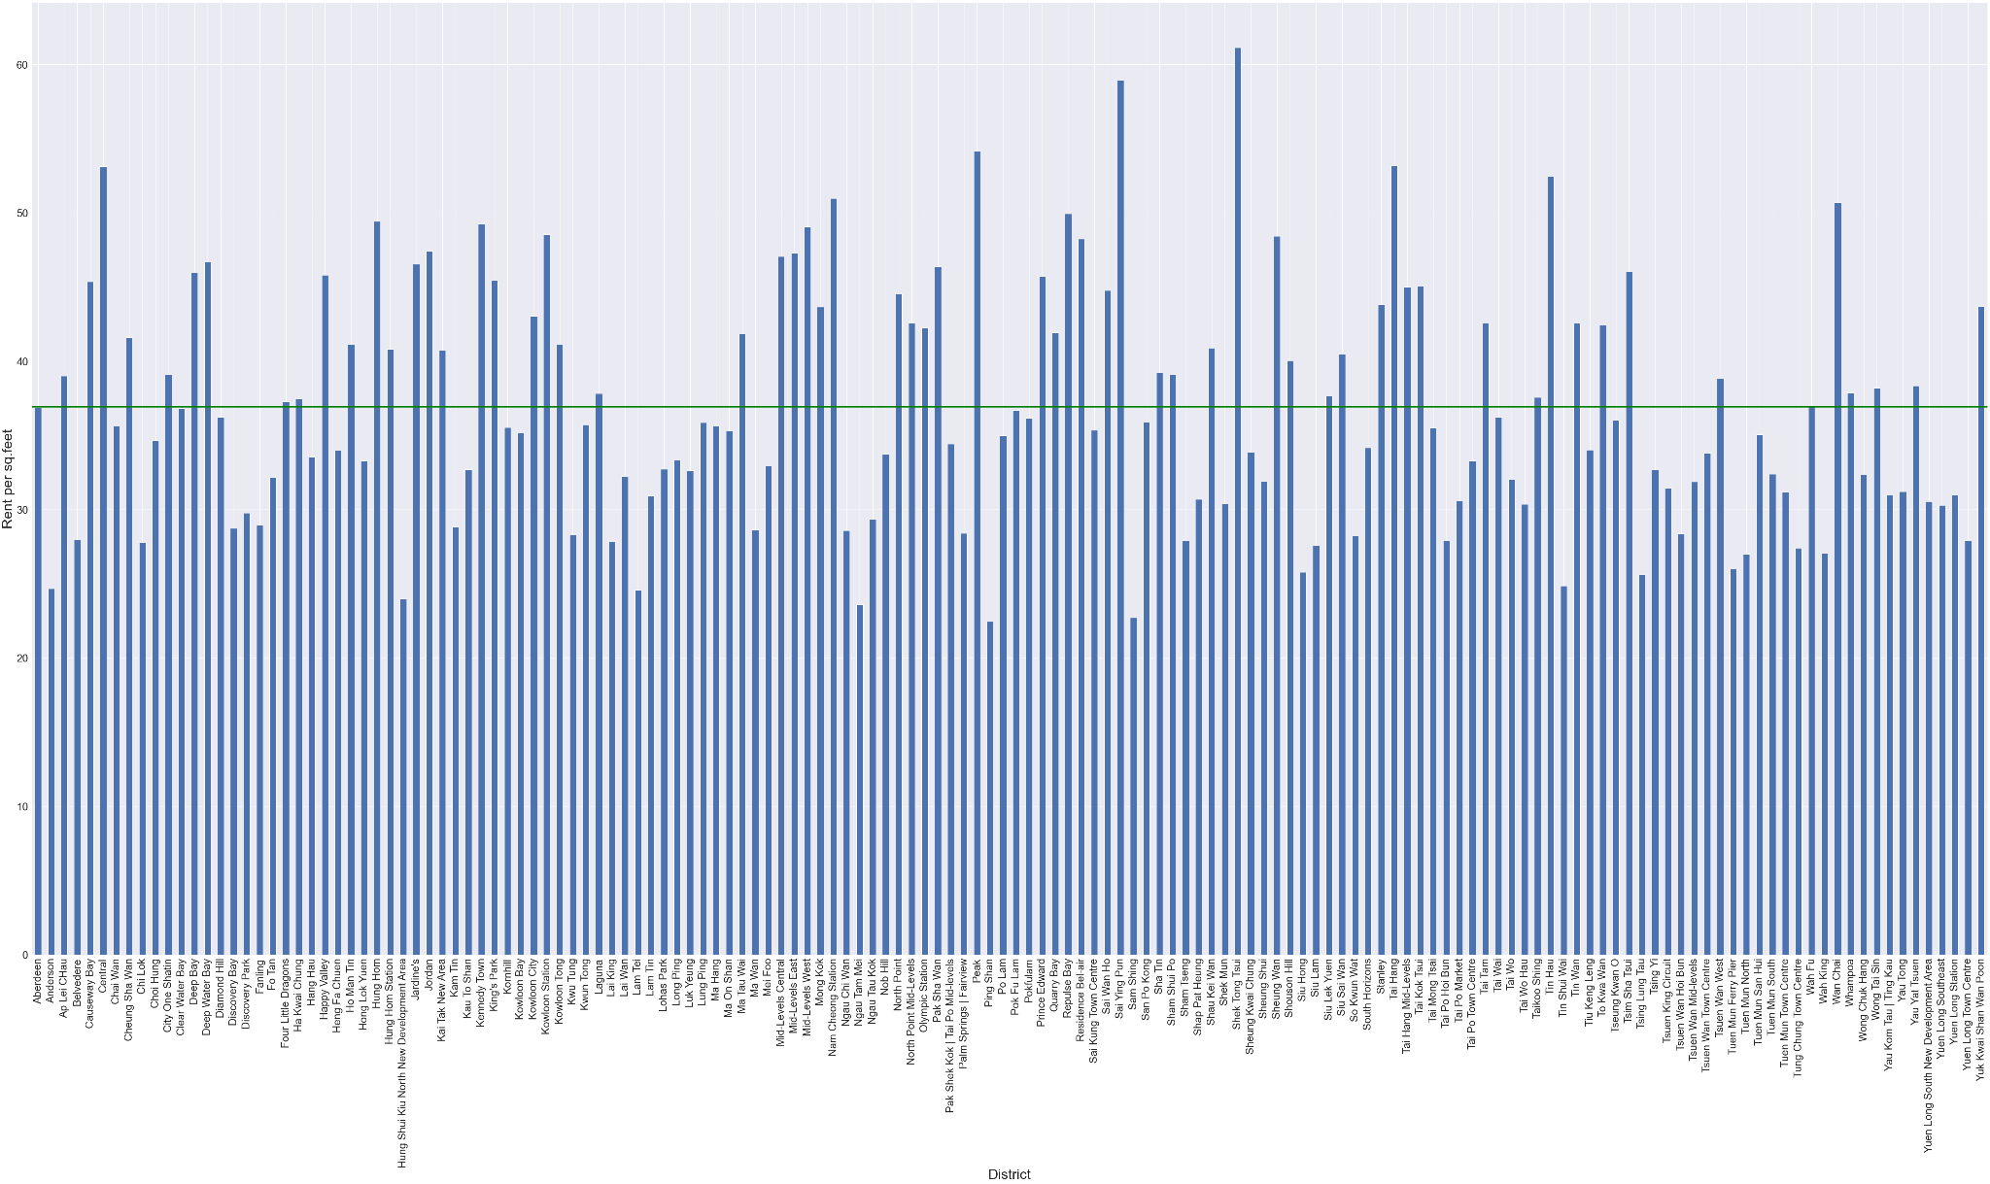
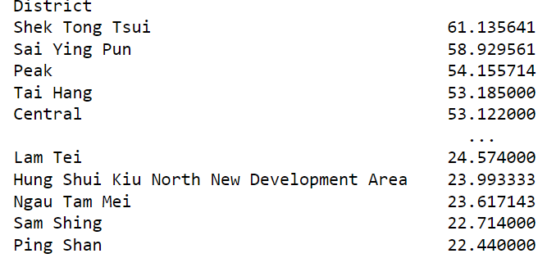
ANALYSIS -
by location (more granular)
Ping Shan has the lowest rent per sqft ($22.44)
Shek Tong Tsui has the highest rent per sqft ($61.14)
Mean rent per sqft across district: $36.93

Slide 10
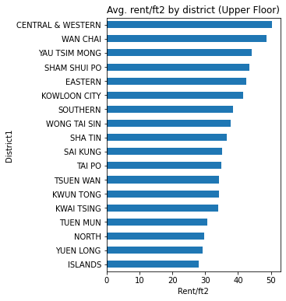
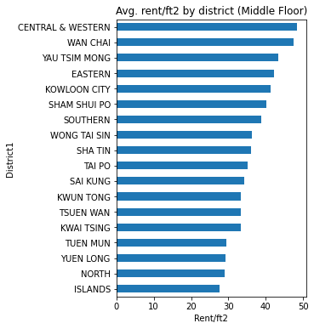
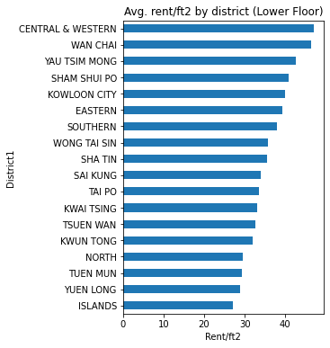
ANALYSIS
○ No significant difference on rent/ft2 between the height of floor towards most of the districts.
○ However, only to the particular districts with high rent/ft2 (in the red frame),
we could observe that the higher the floor, the higher the rent.

Slide 11
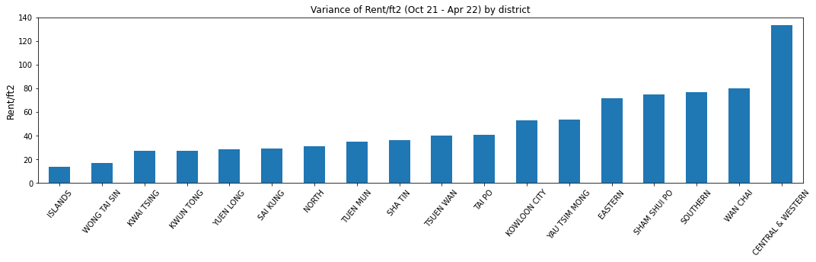
ANALYSIS - Variance on rent/ft2
○ Central & Western resulted the highest variance, followed by Wan Chai, Southern, Sham Shui Po.
Sham Shui Po may be out of a common expectation, as its rent/ft2 variance is high and its avg. price is also higher than the overall average.
○ Most of the districts resulted low variance (< 40) are in New Territories, while some in Kowloon (e.g. Kwun Tong & Wong Tai Sin).
These districts would be nice options for the tenants who seek for a stable rent price.

Slide 12
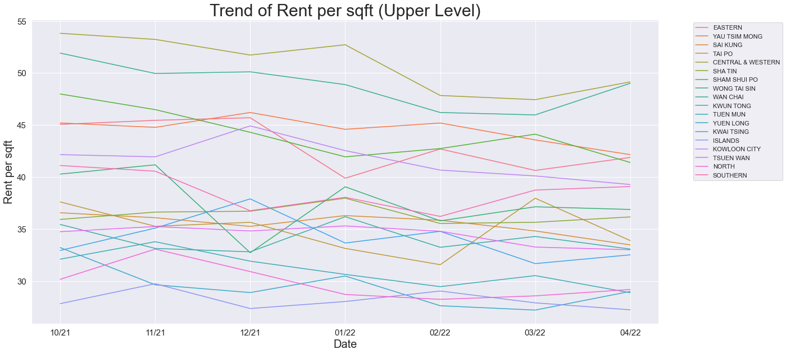
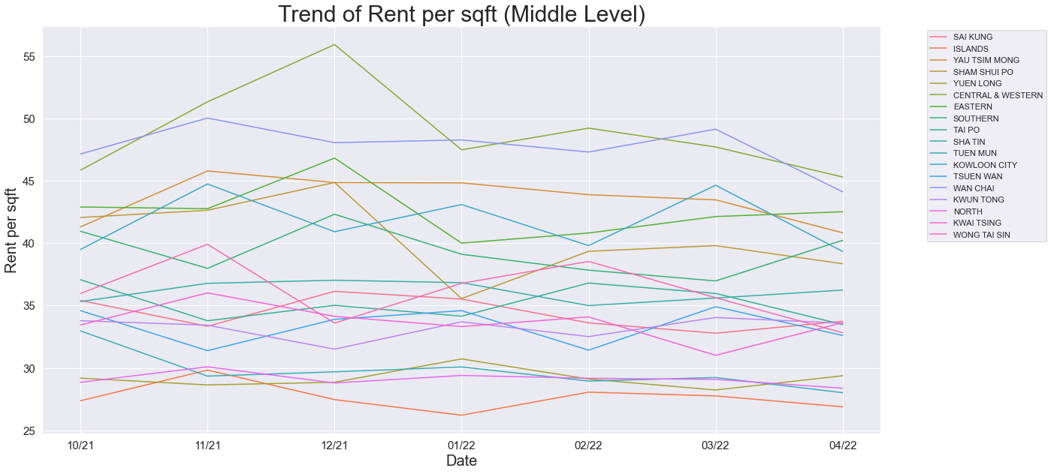
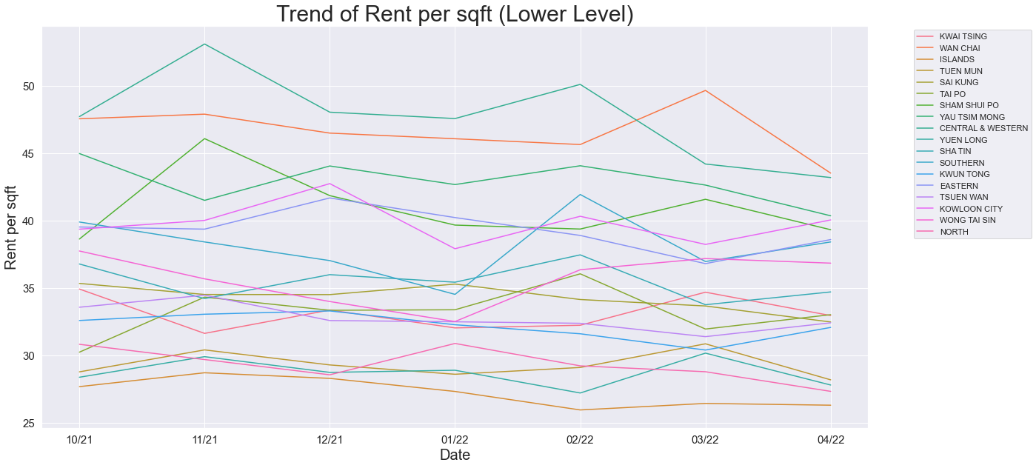
ANALYSIS
Upper Floor (Variance)
Lower Floor (Variance)
CENTRAL & WESTERN | 11.242219
SHAM SHUI PO | 6.595380
SOUTHERN | 5.534533
SAI KUNG | 0.965890
ISLANDS | 0.949330
TUEN MUN | 0.946066
WONG TAI SIN | 8.323637
CENTRAL & WESTERN | 7.062706
SHAM SHUI PO | 5.769079
TSUEN WAN | 0.860433
ISLANDS | 0.829210
SHATIN | 0.699741
Middle Floor (Variance)
CENTRAL & WESTERN | 13.465971
SHAM SHUI PO | 9.463576
WONG TAI SIN | 6.354713
SHA TIN | 0.658602
YUEN LONG | 0.619874
NORTH | 0.292442

Slide 13
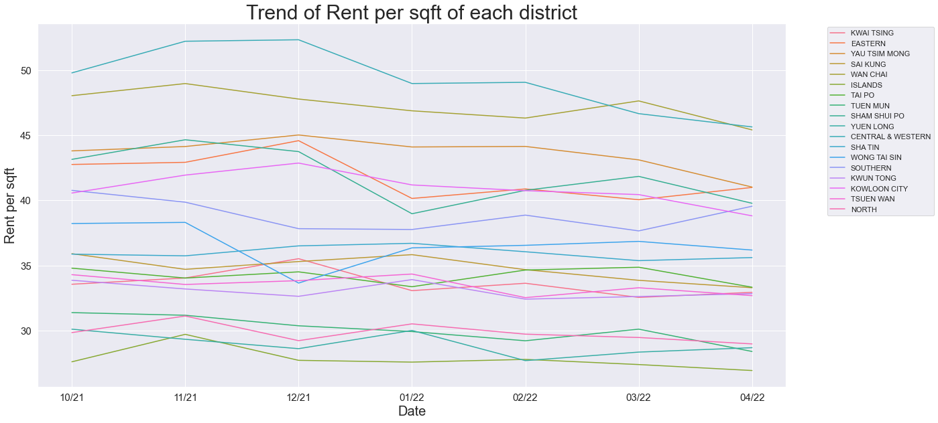
ANALYSIS
Variance (Flutucation)
CENTRAL & WESTERN | 6.409197
SHAM SHUI PO | 4.479968
EASTERN | 2.866646
TAI PO | 0.427730
KWUN TONG | 0.374557
SHATIN | 0.699741

Slide 14
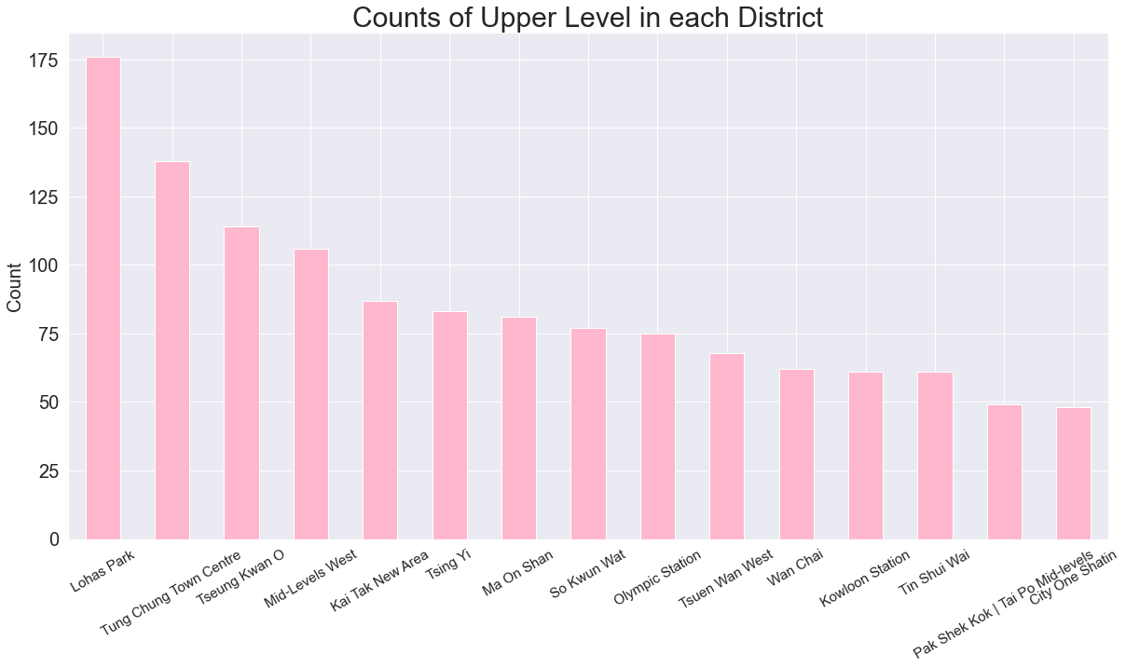
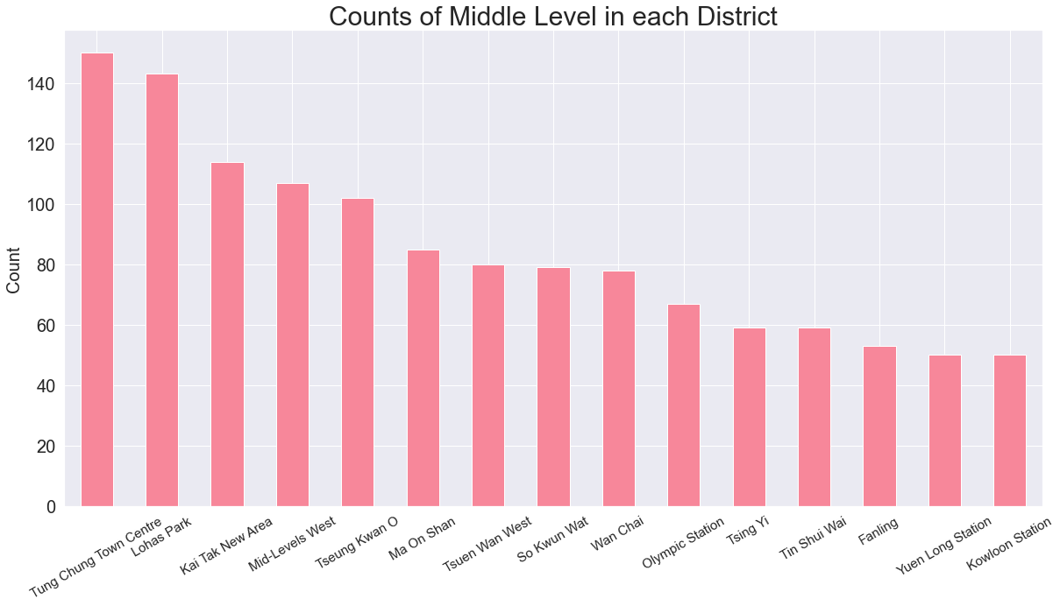
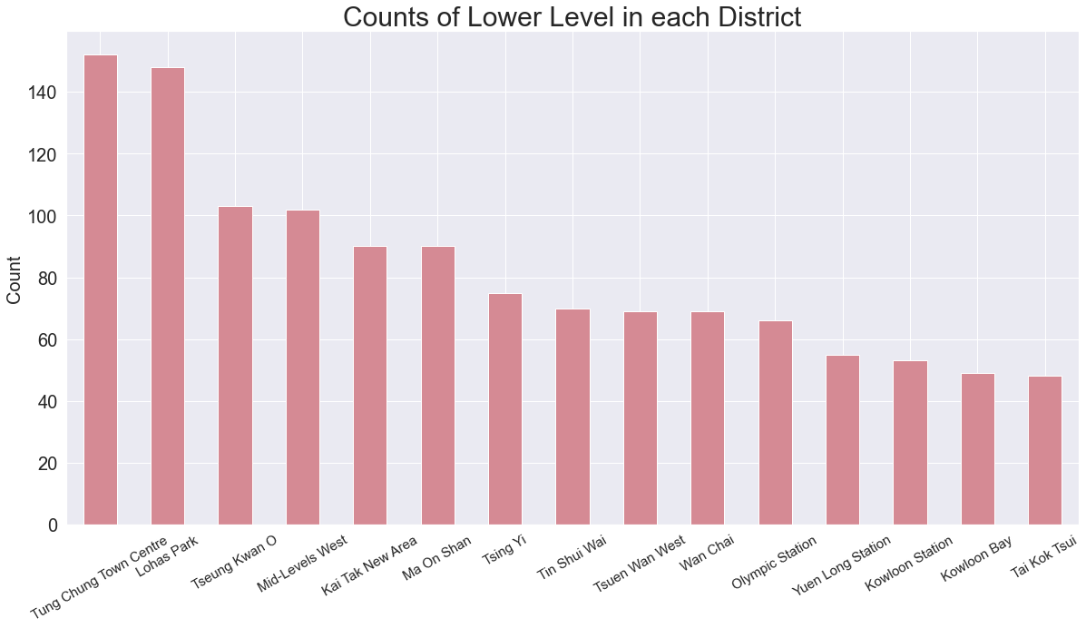
ANALYSIS
The most upper level transactions: Lohas Park
The most middle and lower level transactions:
Tung Chung Town Center

Slide 15
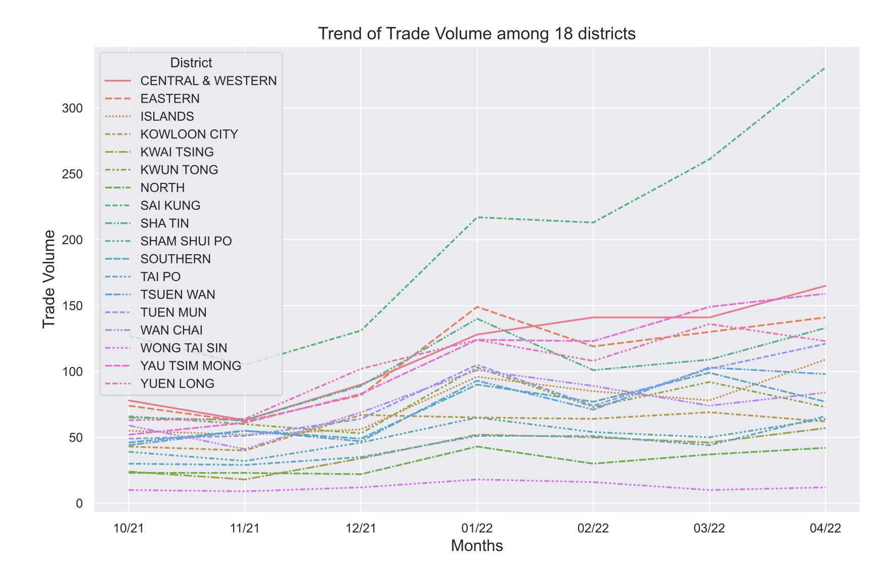
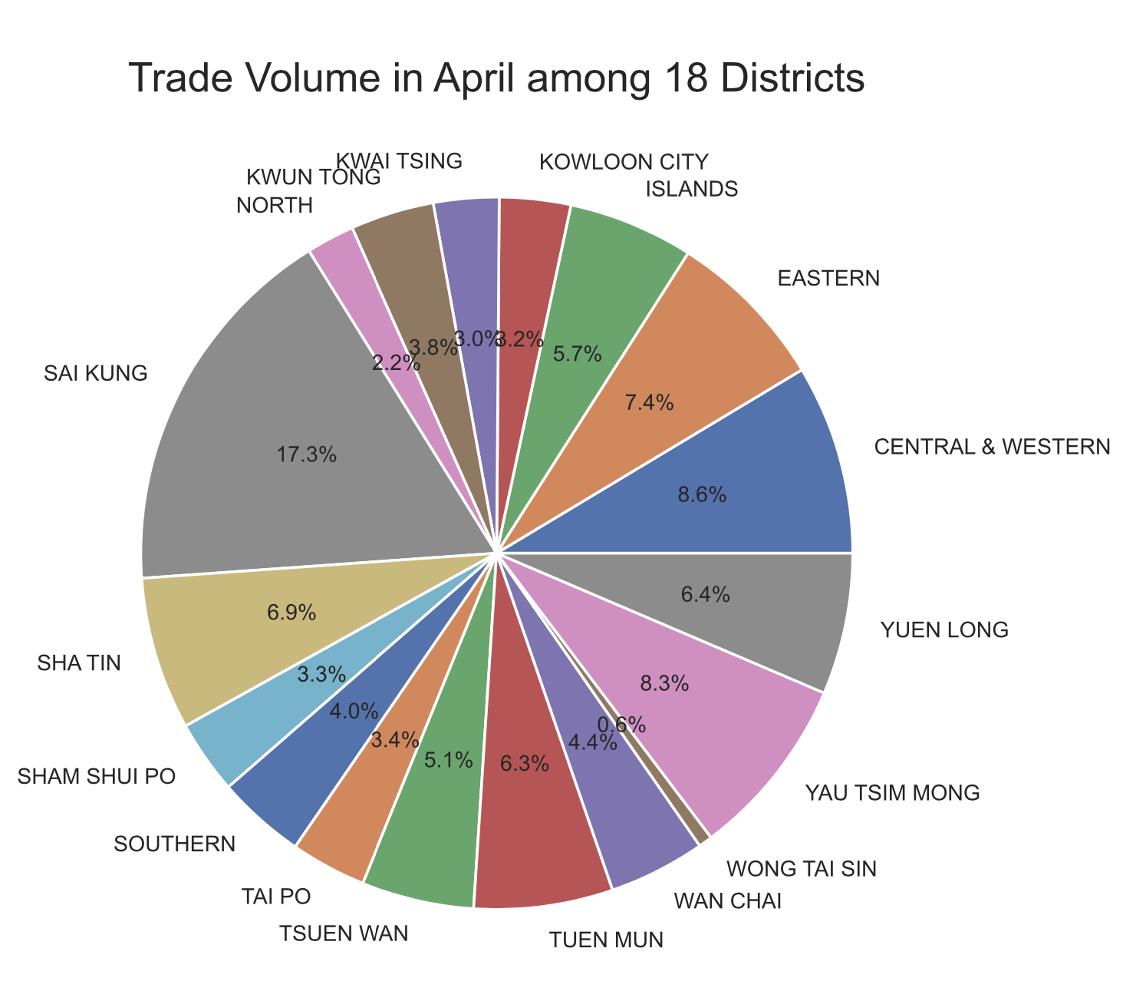
ANALYSIS

Slide 16
CHALLENGES & NEXT STEPS
○ URL on each page do not have pattern, need to use selenium to click through, time-consuming
○ Limited data on agencies’ web (up to 8 months), hard to get a wider picture of the market trend
01
Challenges
○ Scrape through more agencies in order to get a more comprehensive view
○ Forecast trend based on historical data with time series models, generate investment insight
02
Next Steps

Slide 17
CONCLUSION
For Landlords
01
Investment sugguestion: Central & Western district (higher floor) has relatively higher profitability, but need to consider as well the rental yield
For Tenants
02
If not location sensitive, it would be more economic to rent a property on the Islands
For Agencies
Compare the figures among competitors at once, could help implement better business strategies, provide better advice on price setting for landlords clients
03

Slide 18
Thank you

